Slide 1
Venue Name: Region/Market:
Build Your Own Coverage
VENUE JUSTIFICATION PACKAGE
(JP) Template Ver. 6.3

Slide 2
BYOC Template Instructions
Venue Justification Package (JP) Template Ver. 6.3
Template Sections Instructions:
BYOC PARTNER SECTION
To be completed by BYOC Partner.
Please send to BYOC@T-Mobile.com
Please read:
This template is required for all BYOC Justification Package.
All Markets, Regions, ACS must used this latest BYOC template.

Slide 3
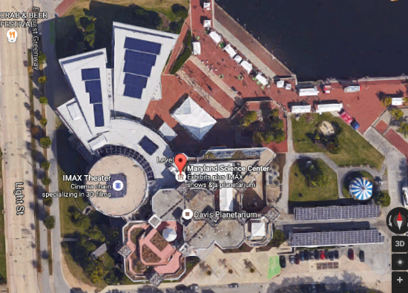
BYOC Partner Inputs: Venue Aerial Map
Venue Justification Package (JP) Template Ver. 6.3
EXAMPLE DATA

Slide 4
BYOC Partner Inputs: Venue Information
Venue Justification Package (JP) Template Ver. 6.3
T-Mobile BYOC Partner Entity Name:
T-Mobile BYOC Partner POC Name:
Contact email/ Phone#:
Legal Venue name:
Location Address:
Venue Overview/Description (please be as descriptive of the venue)
List tenants in the building: (Required for Commercial/Office Building)
Number of units: (Residential Building)
Venue Exclusivity Rights and Term:
Neutral Host or T-Mobile Only (provide anchor carrier if neutral Host)
BYOC DAS Owner:
Venue Property Mgmt/Landlord Name
Venue Property Mgmt/Landlord Contact Name
Venue Property Mgmt/Landlord Number
Venue Property Mgmt/Landlord Email
Venue Property Owned/Leased by DAS Owner | Owned/Leased
Venue Category: (Refer to slide 8)
Venue Sub-Category: (Refer to slide 8)
Total venue Size and Capacity: | Total Venue size (Sq. Ft.):
 | Total Floor Count:
 | Current Attendance or Occupancy:
 | Max. Attendance or Capacity
DAS Coverage Scope/ Planned Coverage area | DAS coverage area (Sq. Ft.)
 | #Floor covered by DAS
 | DAS area occupancy/ Daily Foot traffic
Scope of Work:
DAS iBwave Design available | Yes/No
Benchmark Data available | Yes/No
Customer Circuit Available | Yes/No
Venue Circuit Provider Name

Slide 5
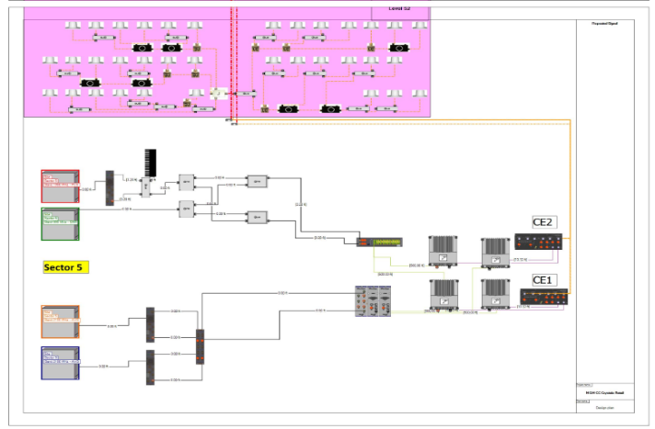
BYOC Partner Inputs: BYOC DAS System
Venue Justification Package (JP) Template Ver. 6.3
DAS Solution Integrator:
DAS equipment manufacturer:
DAS Head-End (Hub) Type/Model:
DAS Remote (Node) Type/Amplifier Output Power:
Number of Sector/Zone
Total Number of Remotes (Nodes):
Allocated Equipment Room Space for T-Mobile equipment (BTS, Router, back-up battery supply):
Allocated Equipment Room Power for T-Mobile (e.g. 60 amps @ 208 VAC – 3 phase):
LEC/AAV or Fiber Providers in Head End (if known):
5G Enabled
EXAMPLE DATA
DAS Architectural diagram: Plan/Building Design

Slide 6
BYOC Partner Inputs: DAS Remote Power Sharing
Venue Justification Package (JP) Template Ver. 6.3
Power Sharing for Neutral Host
Explain and document the power sharing for the Neutral Host Design: (To be provided by Design Vendor or Anchor Carrier)
PA Power assignments by Operator
Band | Operator | Operator Power Sharing % | Composite Power/Remote (W) | Composite Power/Remote (dBm) | Composite Power/Operator (W) | Composite Power/Operator (dBm)
AWS | T-Mobile
 | AT&T
 | VZW
 | Sprint
PCS | T-Mobile
 | AT&T
 | VZW
 | Sprint
700 MHz | T-Mobile
 | AT&T
 | VZW
 | Sprint

Slide 7
BYOC Partner Inputs: Anticipated Costs for T-Mobile
Venue Justification Package (JP) Template Ver. 6.3
Please review and confirm below. All BYOC intake must have $0 Capital Contribution and $0 Monthly Rent.
Please review and confirm below. All BYOC intake must meet below operational expense requirements.
DAS Preliminary Proposal Cost
Capital Contribution: | $0 for BYOC
Monthly Rent: | $0 for BYOC
Monthly Maintenance** | $0 for BYOC
Operational Expenses | T-Mobile | BYOC Partner
Backhaul (T-Mobile) | X
BTS/Repeater Repair & Maintenance (T-Mobile) | X
Equipment Room Maintenance |  | X
Power/Utility |  | X
DAS Monitoring |  | X
DAS Equipment Repair & Maintenance |  | X
DAS Personal Property Taxes |  | X
DAS Remote Unit Power |  | X
**MRC for maintenance must be reviewed by Site Development Manager
Please note that you have options with BYOC. Please indicate which model you are pursuing for this Venue BYOC Opportunity.
Option Type | T-Mobile
BYOC Express
BYOC Hybrid
BYOC Original
Passpoint
CBRS
How Mobile Works Link

Slide 8
T-Mobile Venue Category and Sub-category
Venue Justification Package (JP) Template Ver. 6.3

Slide 9
B2b Sales Inputs: @Work Account Information
Venue Justification Package (JP) Template Ver. 6.3
Name of Account Manager/Sales Representative:
Account/Customer Full Legal Entity Name:
Account BANs# (provide all opened BAN#):
Customer Contact Name & phone number:
@Work Sales Engineer contact:
@Work Account Status: (Prospect, Active-Customer, Customer retention)
Current Total Lines in account:
Current Account MRC: (EIP not included, Service revenue Only)
Current Account In-building Coverage Budget: (3x MRC)
Potential line add:
Potential MRC increase:
Potential iBC Budget increase:
Description of the need for new or improved coverage/capacity at this location; what are the problems or limitations of current service.
Please provide any alignment with Sales, with relevant B2B sales information including total corporate liable lines as well as individual liable lines.
Describe the potential of customer adds/customer satisfaction.
Provide a clear description of what is needed.

